Slide 1
BSc Ist Year
CHEM 102 TH
SECTION A
LIQUIDS

Slide 2
Topic 1 :SURFACE TENSION
Definition,Units
Theory
Formula used
Apparatus required
Procedure
Observations
Calculation
Result.

Slide 3
Definition and Units
Force acting per centimeter along the surface of the liquid at right angles to any line taken in the surface of the liquid in any direction.
CGS UNITS :Dyne/cm
SI UNIT : N/m
1N/m = 10³ dynes/cm

Slide 4
THEORY BEHIND SURFACE TENSION
Surface tension is the property of liquids which arises due to the behaviour of molecules at the surface being different from the behaviourof the molecules in any other portion of the liquid.
A molecule at the surface of liquid is subjected to only attractive forces below it.This creates an imbalance of forces at the surface of liquid .This force acting towards the interior is called surface tension

Slide 5
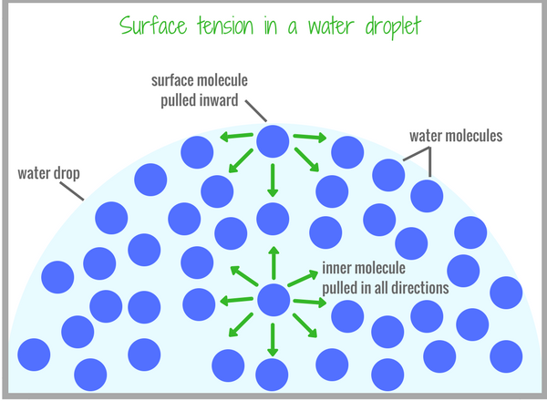
Intermolecular forces in liquids

Slide 6
MEASUREMENT OF SURFACE TENSION
It is based on the fact that drop of liquid at the lower end of capillary falls down when weight of drop becomes equal to surface tension.
Force of gravity pulling drop down=v.d.g
V=volume,d=density,g=acceleration due to gravity
Force upholding the drop =2 ∏ r wher 2 ∏ r is circumference of surface and Ὺ is surface tension.
At equilibrium
2 ∏ r Ὺ =vdg
v =volume of each drop=V/n ,n=number of drops and V = Volume of liquid.

Slide 7
RELATIVE SURFACE TENSION
If n1 and n2 are the number of drops of two liquids of same volume and densities d1 and d2 ,then
2 ∏ r Ὺ 1 = V.d1.g/n1
2 ∏ r Ὺ 2 = V.d2.g/n2
Dividing the two equations
Ὺ1/ Ὺ 2 =n2d1/n1d2

Slide 8
FORMULA USED
Ὺ1/ Ὺ 2 =n2d1/n1d2
This formula is used to determine surface tension of liquid by drop number method using stalagmometer.
n1 and n2 are determined with stalagmometer for the two liquids out of which one is distilled water and the other is given liquid.

Slide 9
Apparatus Required
Stalagmometer
Stand for stalagmometer
Rubber tubing
Beaker
Sop watch
Specific gravity bottle
Weighing balance

Slide 10
Determining density of given liquid using specific gravity bottle
Weight of empty bottle =w1 g
Weight of bottle +water =w2 g
Weight of bottle +liquid =w3 g
Density of liquid d1 =w3-w1
Density of water d2 w2-w1
d1 =w3-w1 × d2
w2-w1

Slide 11

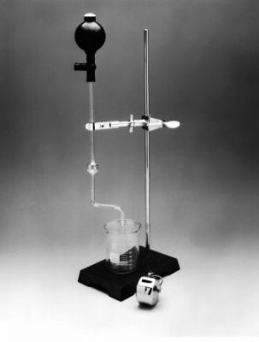
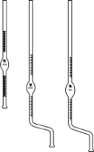
Stalagmometer to determine n1 &n2
(Refer formula )
Ὺ1/ Ὺ 2 =n2d1/n1d2

Slide 12
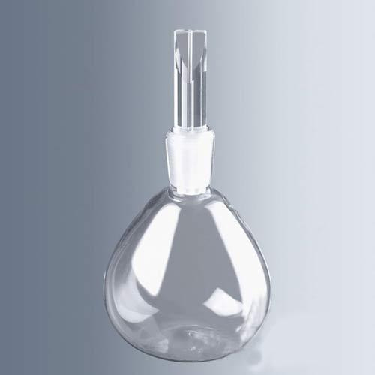
Specific gavity bottle

Slide 13
SOME BASIC QUESTIONS
What type of intermolecular forces exist in a liquid surface?
How can you explain the concept of surface tension?
How is density of a liquid determined?
Which instrument is used to determine surface tension of a liquid?
What are the units of surface tension?
Why is a drop sherical in shape?
What is the relation between surface tension and the
Strength of forces between particles?

Slide 14
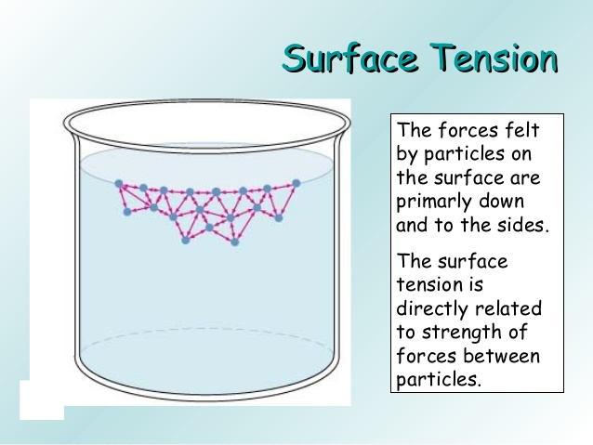
Thanx with a note that this topic is in your practical syllabus also ,so kindly try to understand it properly.

